Slide 1

Purity, side effects and idempotence
An introduction to JavaScript concepts, with slight nuances of TypeScript and Functional Programming..

Slide 2

Be wary, travelers!!
At the end of the talk, access will be shared:
To the recording
To the slides

Slide 3
Presentation
I'm Pepe, currently a front-end developer, working with React and TypeScript. And almost always tinkering with different technologies.

Slide 4

What will we see in this talk?
Introduction to some JavaScript concepts
Brief introduction to functional programming concepts
Purity of functions
Side effects of a function
Idempotence

Slide 5

How useful are they to us?
They help us to better understand our work tool, JavaScript, Java, Python.
They can guide us to a clearer and higher quality code.
Some of these concepts are technical interview questions.
They serve as a basis for applying "more complex" techniques.
They are applicable to other languages: Java, C#, Python, etc.

Slide 6

who is it aimed at?

Slide 7

AIMED AT…
Those who are just starting out
Those who want to get into the world of JavaScript
Those who want to get started in functional programming
Those who want to discover something new today

Slide 8

Notice
JavaScript is not required for this talk, but will be the language of choice for examples and concept grounding.

Slide 9
Functional programming
Functional programming is a programming paradigm.

Slide 10
What is a programming paradigm?
A programming paradigm is nothing more than a programming style, with advantages and disadvantages. OOP/POO is a well-known one.

Slide 11
The functional programming checklist
The "meat", what is functional programming?
Declarative programming
Divide and conquer
More mathematical functions
With deterministic results

Slide 12

Purity

Slide 13
Definition of Purity
The purity of a function is inversely proportional to the amount of side effects it has.
Fewer side effects make a function purer.

Slide 14
Purity and side effects
Pure functions have as few side effects as possible.
Functional programming understands that side effects are sometimes necessary.

Slide 15
Purity and determinism
A pure function has a deterministic result.
Its result is expected, i.e., you can determine its result if you know what arguments you are passing to it.

Slide 16
Purity, unifying concepts
A pure function is one with a deterministic outcome that has as few side effects as possible.

Slide 17
BUT…
What is this side effect?

Slide 18

Side effects

Slide 19
Defining side effects
The side effects of a function can be understood as actions that go beyond the scope of a function.

Slide 20
The checklist of a side effect
Depends on a state(value, attribute, property, constant) not provided as a parameter.
Mutate (modify) a non-local state, outside the body of the function.
If it fulfills one of these properties, the action (instruction) becomes a side effect

Slide 21
Understanding side effects
But then, don't we have to have them? Yes, you have to have side effects, what you have to do is to minimize their use.
A side effect "damages" the trace, it is an extra mock within a test, it makes the result of a function somewhat more unpredictable.

Slide 22
examples
With examples, everything is better understood.
Let's say that we have retrieved information about a user from the DB, but we don't want to return all the information, for that, we have a function that filters the body of the answer.

Slide 23
It is a side effect when...
A side effect would be to retrieve the user information in the same function that does the filtering.
Or store the retrieved user information in a global variable and access it to filter the fields to return.
In TypeScript, formatCurrentUser(): ResponseUser.
In Java, ResponseUser formatCurrentUser().

Slide 24
It would not be a side effect if...
Following the example from before, it would not be a side effect if our function receives the user's information and returns the response.
In TypeScript, formatUser(user: User): ResponseUser
In Java, ResponseUser formatUser(User user user)

Slide 25
Contextualizing in JavaScript
In case of being in the frontend, this same case can occur.
We have retrieved the user information from the appropriate endpoint. Assuming that our app is not multilingual.
We would not retrieve the user directly from a store, we would have a function that would be in charge of formatting the user information, formatUser(user: User): string

Slide 26
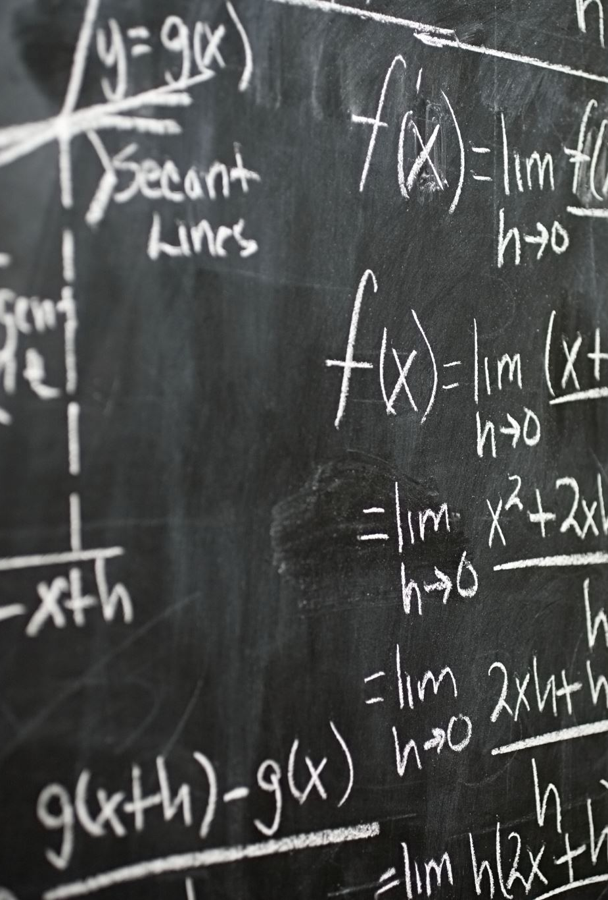
Idempotence

Slide 27
What is idempotence
Idempotence is the property of a mathematical function to be completely pure.
That is, it has no side effects, and its result will always be the same, given that we pass it the same arguments.

Slide 28
Benefits of idempotence
Purity of functions (traceability)
Possibility to save computations
The same result with the same arguments could be cached...
Saying a not so well known word for something that is commonly known

Slide 29
“Trade-off" of idempotence.
Not everything can be, nor should be, idempotent.

Slide 30
Examples of idempotencE
Sum
1 + 1 sometimes outputs 7, but 2 + 2 will always outputs 4
Factorial
The factorial of a number will always be the same, factorial(3) == 6

Slide 31
Examples that are not idempotent
Math.random
It will almost always return a different number
Time.now or Date.now
Time is constantly changing

Slide 32
Let's recap…

Slide 33

we have seen...
Functional Programming
A divide and conquer programming paradigm
Purity
A function with the least amount of side effects and a deterministic result.
Side effects
Mutations and dependencies outside the scope of the function
Idempotence
A pure function, same parameters == same result

Slide 34

Which allows us to...
Write clearer and higher quality code
Understand the ecosystem better
Conduct good technical interviews
New ways to face the same old problems

Slide 35

And now... Where could I continue?
In the following episodes...

Slide 36

Steps to follow
JavaScript oriented memorization
Serialization
Value comparison
Closure
First class citizenship
High order
High-order functions
High-order components

Slide 37
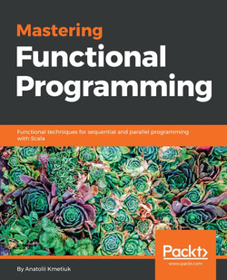
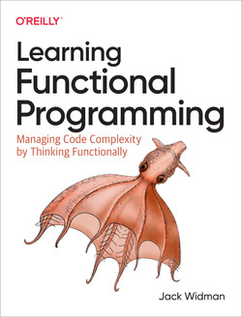
Books
Learning Functional Programming
by Jack Widman, O’Reilly
O’Reilly: https://www.oreilly.com/library/view/learning-functional-programming/9781098111748/
Amazon: https://amzn.eu/d/0CVqCi6
Mastering Functional Programming
by Anatolii Kmetiuk, Packt Publishing
Packt: https://www.packtpub.com/product/mastering-functional-programming/9781788620796
Amazon: https://a.co/d/dBo8L3m

Slide 38

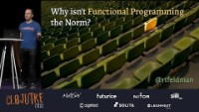

Talks
Anjana Vakil: Learning Functional Programming with JavaScript - JSUnconf 2016
Why Isn't Functional Programming the Norm? – Richard Feldman
Functional Programming for Pragmatists • Richard Feldman • GOTO 2021

Slide 39
Article
You can read the article at
https://medium.com/@jofaval/a60130f073ef
BEWARE!!! Contains spoilers for possible next talks, but the order is the same.

Slide 40
Thank you for your attention
Have a nice day!

